Slide 1
Topic 1 Network Protocols
ST251Y Ethical Hacking and Defences

Slide 2
Topic 1a : Network Protocols
Introduction to Kali Linux
Wireshark
Hypertext Transfer Protocol (HTTP and HTTPS)
Ports
File Transfer Protocol (FTP)
Telnet
SSH (Secure Shell), SCP, SFTP

Slide 3
Kali Linux
A Linux distribution which contains many useful security software
Wireshark
Nmap
etc…
Can be run off a LiveCD or a USB device
www.kali.org
Rebuild of the BackTrack Linux

Slide 4
Practical
Set up your Kali virtual machine
Practical 1a Exercises 1, 2, 3 and 4

Slide 5
Wireshark
Open source packet analyzer
Network traffic can be captured and stored for offline analysis
Displays information in packets in human-readable format

Slide 6
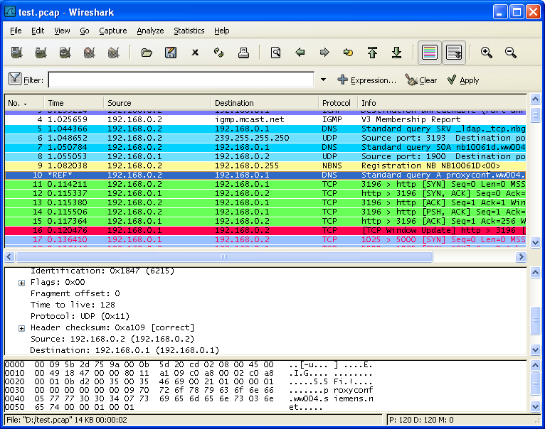
Wireshark
List of captured packets
Protocol details of selected packet
The data bytes of the selected packet (in hexadecimal and in ASCII)

Slide 7
Wireshark
With Wireshark, you can
Understand better how protocols work, eg HTTP
Reassemble captured network traffic

Slide 8


HTTP
When the client requests for a webpage, the request is sent as a HTTP GET method
GET www.sp.edu.sg
SP home page
User
Web Server

Slide 9
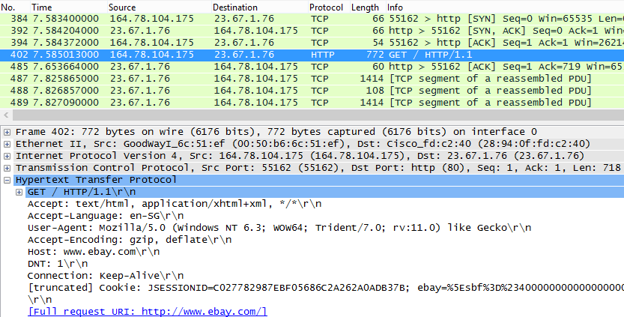
HTTP GET
HTTP GET packet (request for webpage from server)
Host visited : www.ebay.com

Slide 10
HTTP
When the client submits some data in a webform, the data is sent as a HTTP POST method
POST login-form
Successful login message
on webpage
User
Web Server

Slide 11
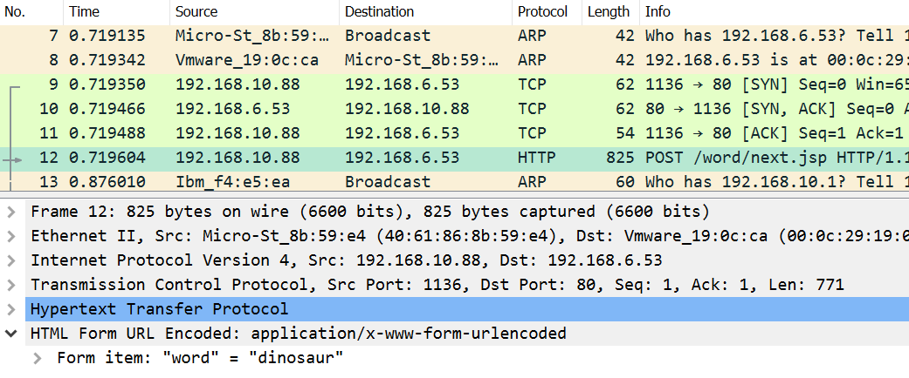
HTTP POST
HTTP POST packet (submit a webform to server)

Slide 12
HTTP Methods
GET method
To request data (eg webpage) from web server
Most commonly used HTTP method
POST method
To send data (eg webform) to web server

Slide 13
HTTP Methods
HEAD method
Similar to GET but returned packet only has HTTP headers, with no response body. Used for testing.
PUT method
To replace a resource specified in URL
DELETE method
To delete a resource specified in URL
TRACE method
Perform a loopback test to the resource specified in URL
OPTIONS method
Describe communication options available

Slide 14
HTTP and HTTPS
HTTP
Normally runs on Port 80
Data not encrypted
HTTPS
Used to encrypt the HTTP data
Normally runs on Port 443

Slide 15
Netstat
Netstat is a command available on both Windows and Linux to display opened ports and current connections

Slide 16
Comparing different protocols for remote access
FTP
Telnet
SSH, SCP, SFTP
Remote desktop (in next lesson)
Computer A
(Client)
Computer B
(Server)
Remote login to Computer B

Slide 17
File Transfer Protocol
Protocol for copying files between systems
The FTP Server normally runs on
Port 21 for control connections
Port 20 or other ports for data connection
No encryption (all data, including passwords sent across network in plaintext)
Can use alternatives like SFTP
Computer A
(Client)
Computer B
(FTP Server)
Upload or download files

Slide 18
Telnet
Telnet allows a user to login remotely to another system.
The Telnet Server normally runs on Port 23.
Another old protocol, data not encrypted.
Should use more secure alternatives like Secure Shell (SSH)
Computer A
(Client)
Computer B
(Telnet Server)
Remote login to Computer B

Slide 19
Secure Shell (SSH)
A popular application used for remote login.
The SSH service normally runs on Port 22.
Data is sent encrypted across the network.
SCP (Secure Copy) and SFTP (Secure FTP) work over SSH protocol to allow secured file transfers

Slide 20
Topic 1a Network Protocols Summary
Introduction to Kali Linux
Using Wireshark
Analyse HTTP traffic
Reassemble network packets
Using Netstat to view opened ports
File Transfer Protocol (FTP)
Telnet
SSH (Secure Shell), SCP, SFTP

